Slide 1
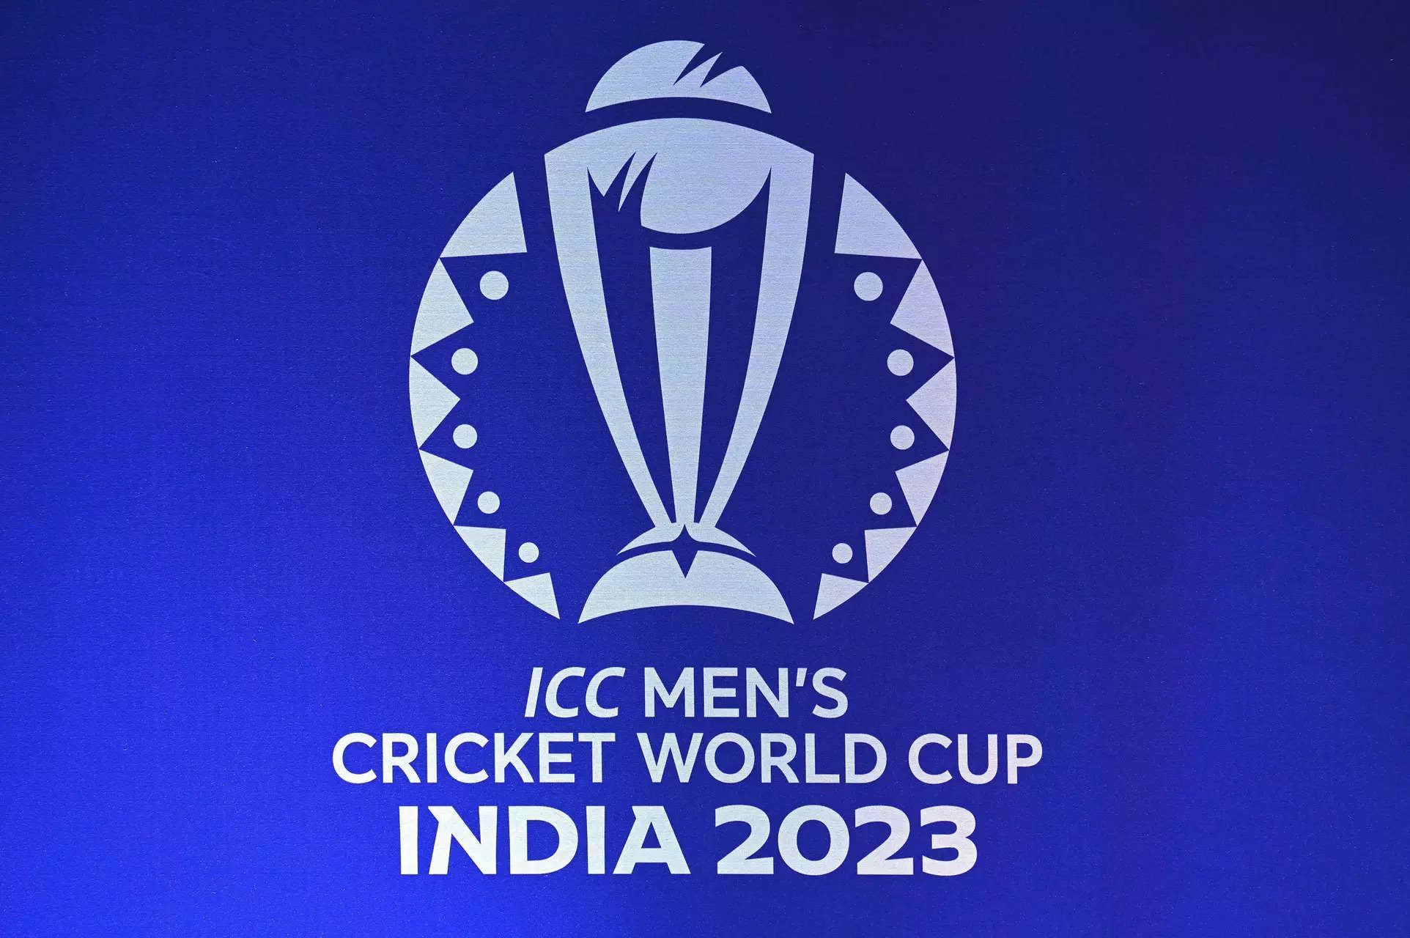

Slide 2
World Cup 2023
Data Analysis

Slide 3

INTRODUCTION
The ICC Men's Cricket World Cup 2023 is the 13th edition of the premier international cricket tournament. It is scheduled to be held in India and features the world's top cricket teams competing in One Day International (ODI) matches. The tournament showcases cricketing excellence and is a highly anticipated event, with teams vying for the coveted title.

Slide 4
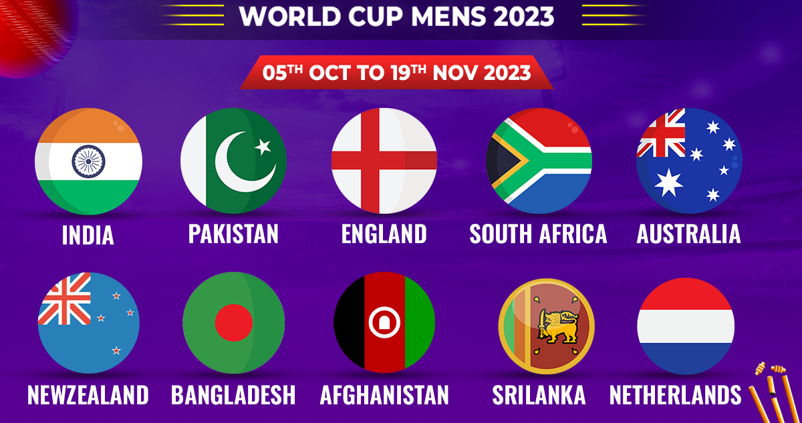

Slide 5
Procedure:
Identifying problem statement
Import Necessary Libraries
Data Loading
EDA
Conclusion
Problem Statement:
Performing a detailed exploratory data analysis on the World Cup 2023 dataset. The goal is to uncover patterns, trends, and notable statistics that provide a delicate understanding of team and player performance. The analysis should encompass both batting and bowling aspects, considering key metrics such as runs, wickets, strike rate, economy rate, and other relevant factors.

Slide 6
Libraries:
Numpy
Pandas
Matplotlib
Seaborn
Data Loading:
Team - player - bat_or_bowl
bb_bf (balls bowled or balls faced) - runs - wkts (wickets)
wicketball_prob - runs_per_ball - opposition
ground - start_date - overs
mdns (maidens) - econ (economy rate) - inns (innings)
4s (fours) - 6s (sixes) - sr (strike rate)
not_out - mins (minutes)

Slide 7
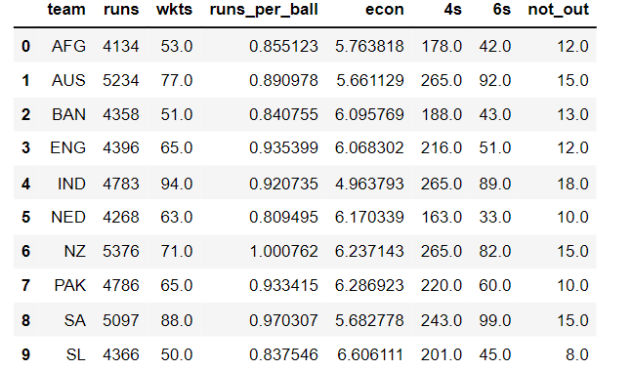
Exploratory Data Analysis
1. Team Performance Analysis:

Slide 8
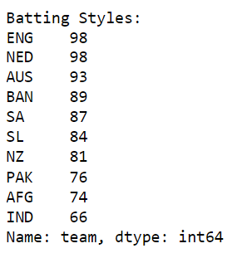
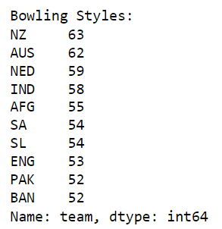

Slide 9
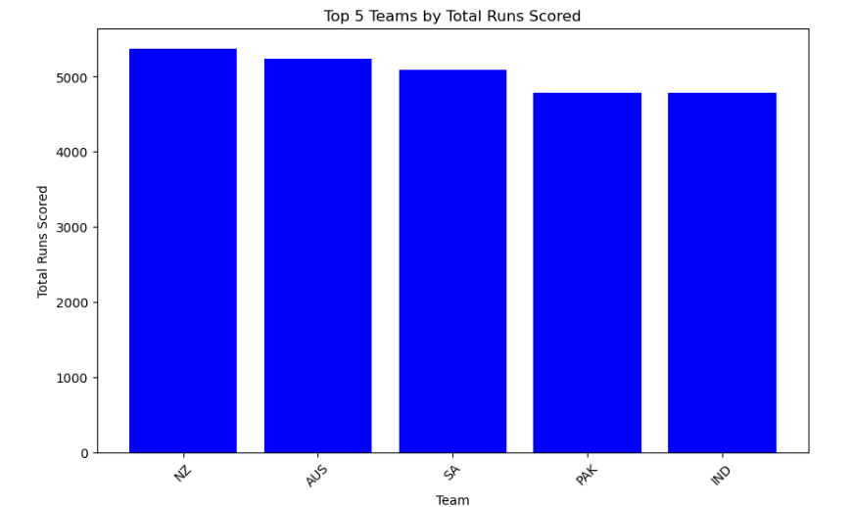
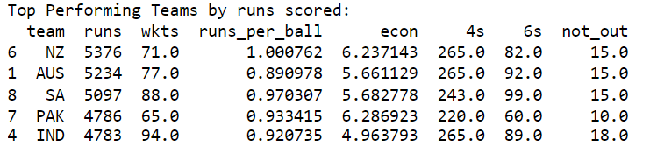

Slide 10
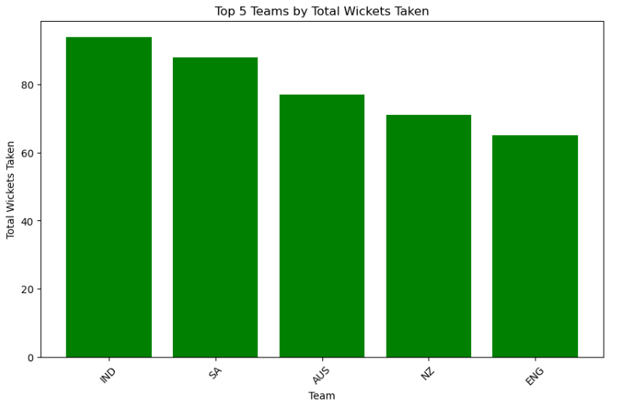
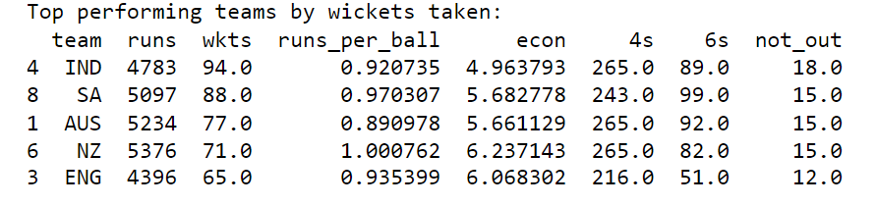

Slide 11
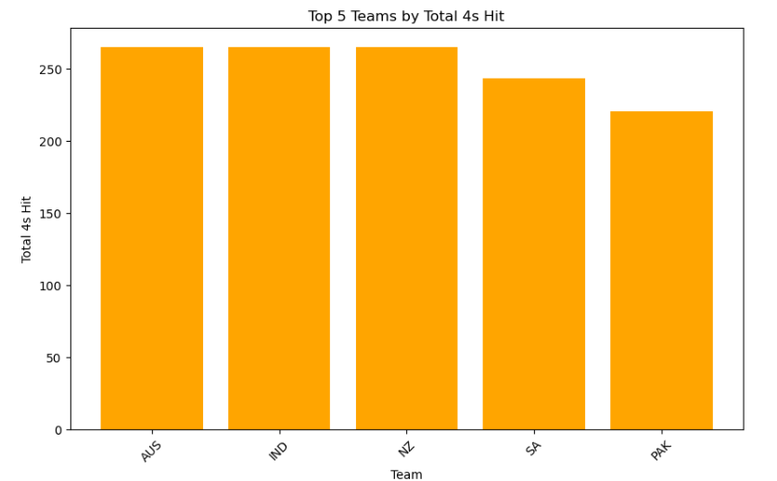
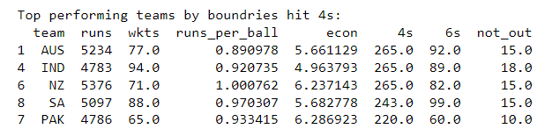

Slide 12
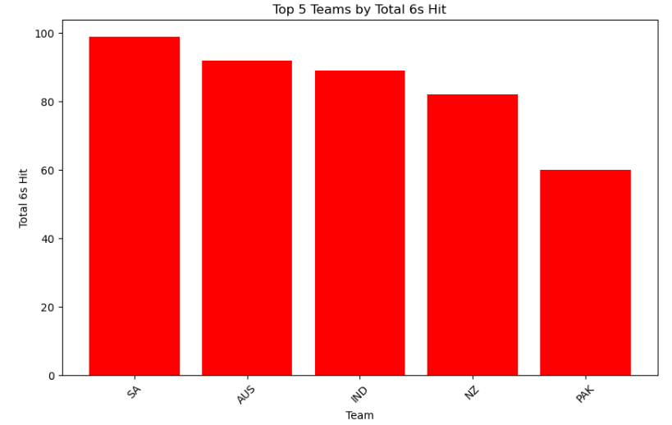
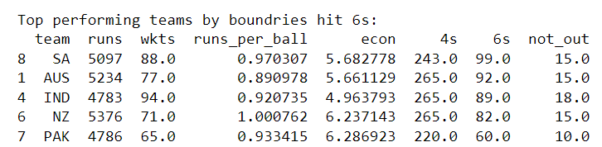

Slide 13
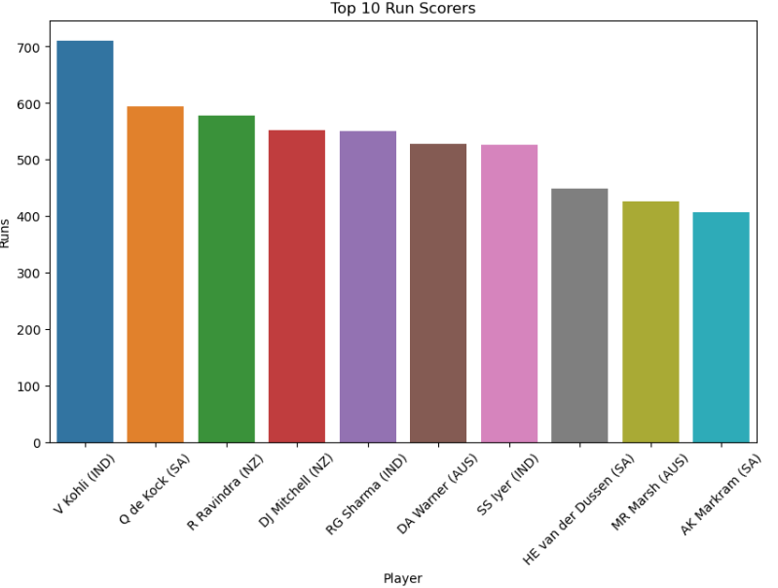
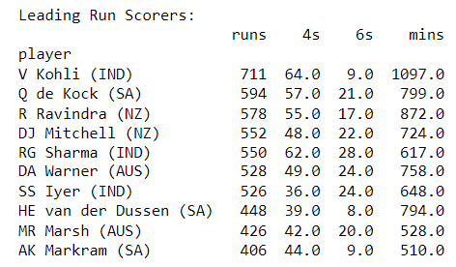
2. Player Performance Analysis:

Slide 14
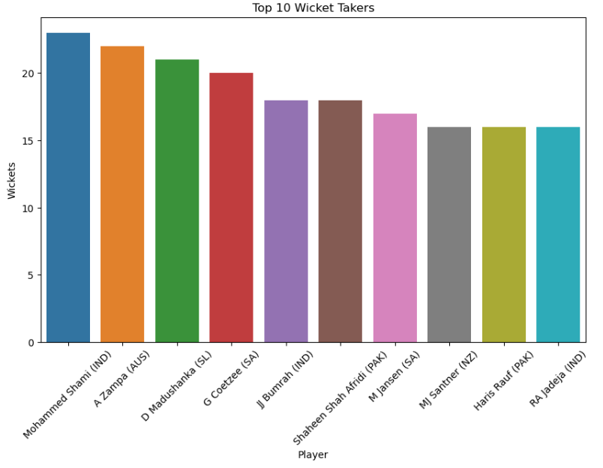
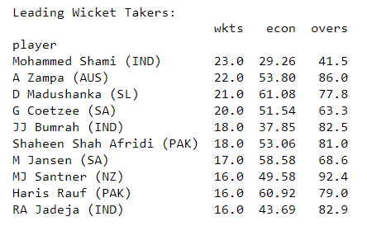

Slide 15
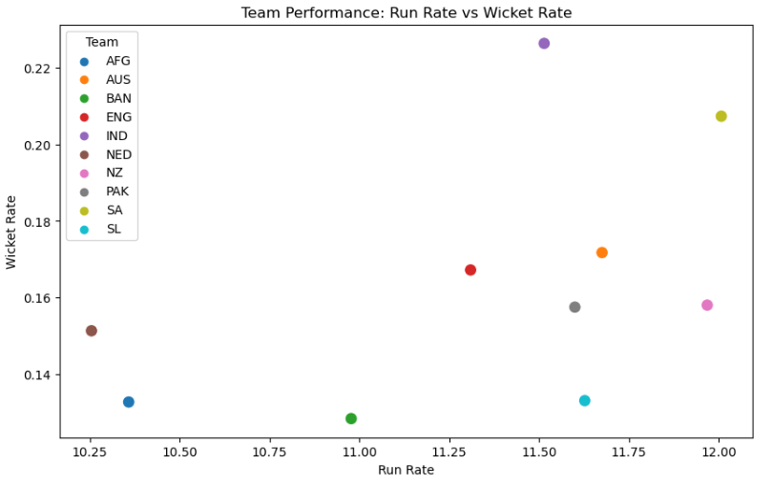
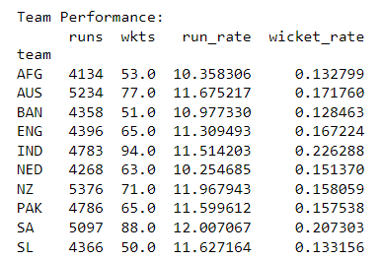

Slide 16
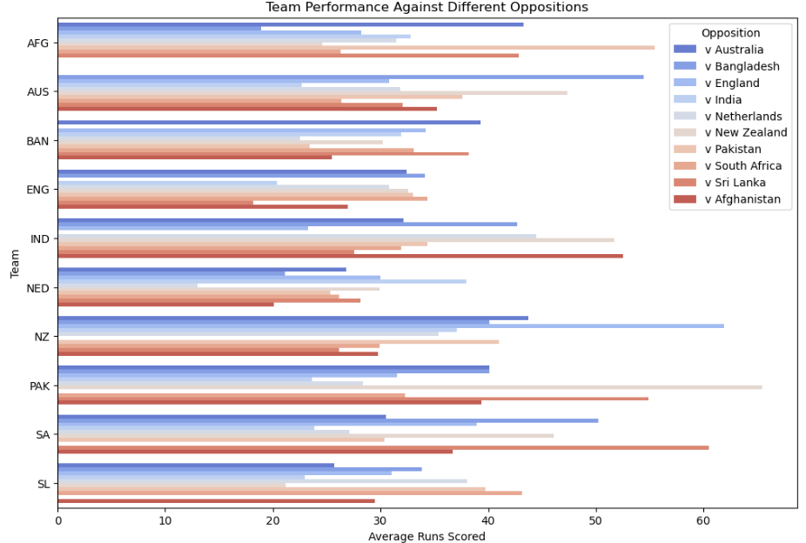
3. Opposition & Ground Analysis:

Slide 17
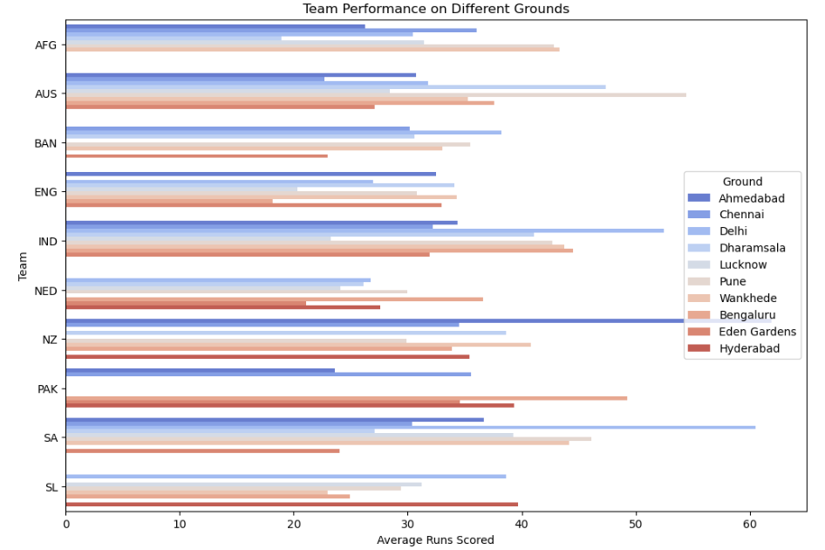

Slide 18
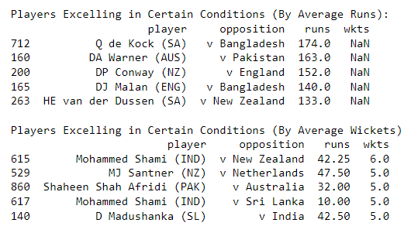
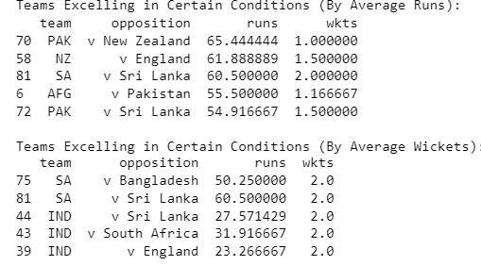
Team-wise Performance Analysis :
Player-wise Performance Analysis :

Slide 19
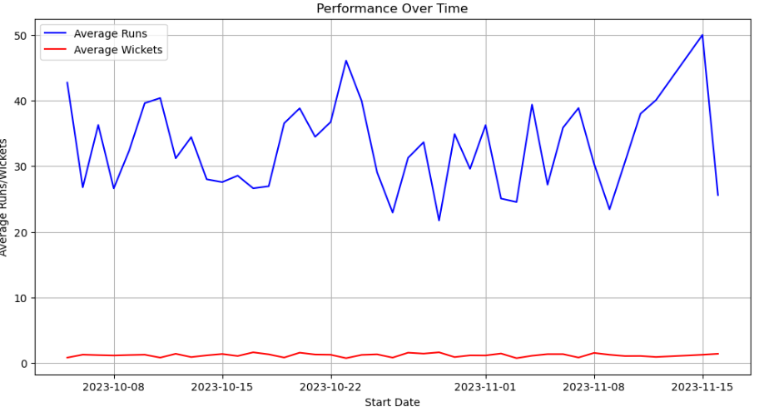
4. Temporal Analysis:

Slide 20
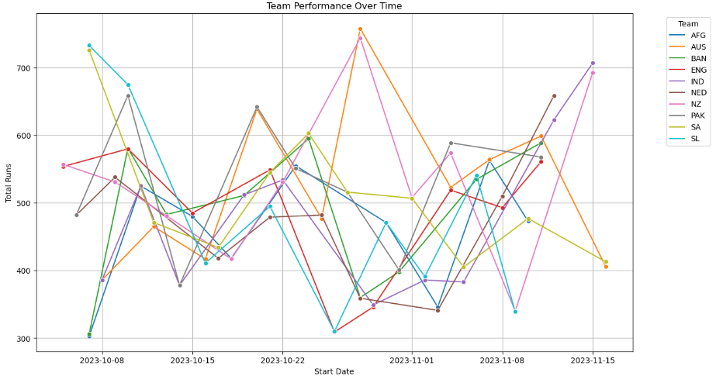

Slide 21
